Slide 1
Lesson 3 - Array Length and Looping Through Arrays
Mr Mack 2019

Slide 2
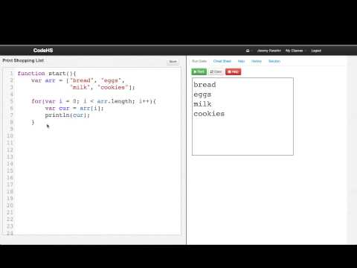
Array Length and Looping Through Arrays

Slide 3
How can we get the length of an array arr?
arr.len
arr.length
length(arr)
arr.length()

Slide 4
Which loop will correctly loop over the array arr and print each value inside of it?
for(var i = 0; i < arr.length(); i++){
var curr = arr[i];
println(curr);
}
for(var i = 1; i <= arr.length(); i++){
var curr = arr[i];
println(curr);
}
for(var i = 0; i < arr.length; i++){
var curr = arr[i];
println(curr);
}
for(var i = 1; i <= arr.length; i++){
var curr = arr[i];
println(curr);
}

Slide 5
Example: Print Shopping List
This is an example for this lesson. You are encouraged to play around with it, run and change the code, and learn how it works. When you are done, click continue to go to the next problem.

Slide 6
Example: Sum Array
This is an example for this lesson. You are encouraged to play around with it, run and change the code, and learn how it works. When you are done, click continue to go to the next problem.

Slide 7
Exercise 5.3.1: Product of List
Write a program that outputs the product (the result of multiplying together) all of the elements in an array.
Create an array arr with the values [1, 8, 3, 4, 2, 9].
The answer should be 1728.

